Slide 1
TRAFFIC SIGN RECOGNITION
WITH
VOICE ALERT SYSTEM
Presented By :
Koduru Pooja - 18011A0420
Saka Srinivasulu - 19015A0422
Reshma - 18011A0437
Sharafuddin - 18011A0459
UNDER THE GUIDANCE OF
Dr. Makkena Madhavi Latha
Professor Of ECE & Director,
Academic and Planning JNTUH

Slide 2
CONTENTS
Introduction
Goal and Methodology
Need for Traffic Sign Recognition system
Flowchart
Dataset Collection
Training and Testing
LeNet
Results
Advantages and Disadvantages
Future Scope
Conclusion

Slide 3
INTRODUCTION
A major cause of road accidents is negligence in viewing the Traffic signboards and interpreting them incorrectly.
There have been a lot of technological advancements have come up to overcome them. Autonomous vehicles have come into existence.
However, these features are available only in some high end cars which are not affordable to the masses

Slide 4
GOAL
The proposed system helps in recognizing the Traffic sign and sending a voice alert through the speaker to the driver so that he/ she may take necessary decisions.
METHODOLOGY
The proposed system is implemented by first Capturing the Image and then Pre-process it. Later, using LENET-5 deep neural network the traffic sign is detected. Then by using SoftMax layer of the neural network the traffic sign is recognised, and a voice alert is sent.

Slide 5
Need For Traffic Sign Recognition System
Autonomous vehicles have come into existence. However, these features are available only in some high end cars which are not affordable to the masses. So an affordable TSR system which helps in easing the job of driving to some extent is required. The necessity for this system can be summed up as –
Safety
Warning Function
Alerting the driver
Affordability

Slide 6
FLOWCHART
Dataset Collection
Training and Testing
Traffic Sign Recognition
Voice Alert

Slide 7
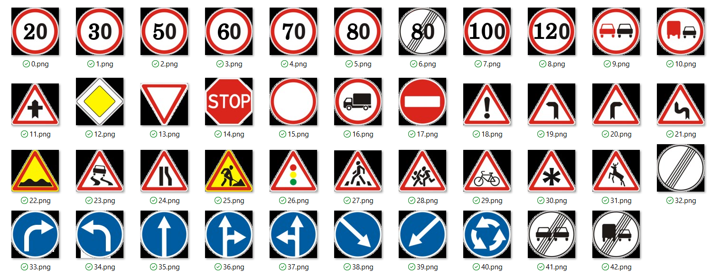
Dataset Collection
(a) German Traffic Sign Board Recognition Benchmark Dataset

Slide 8





Stop Priority Speed Limit Ahead only Pedestrians
Road 20 km/hr
(b) Developed Dataset
The German Traffic Sign Benchmarks Dataset was used, which contains approximately 43 categories and 51,900 images of traffic signs.
A developed dataset is also considered to verify the model’s performance with a smaller dataset, in comparison to a large and standard dataset.

Slide 9
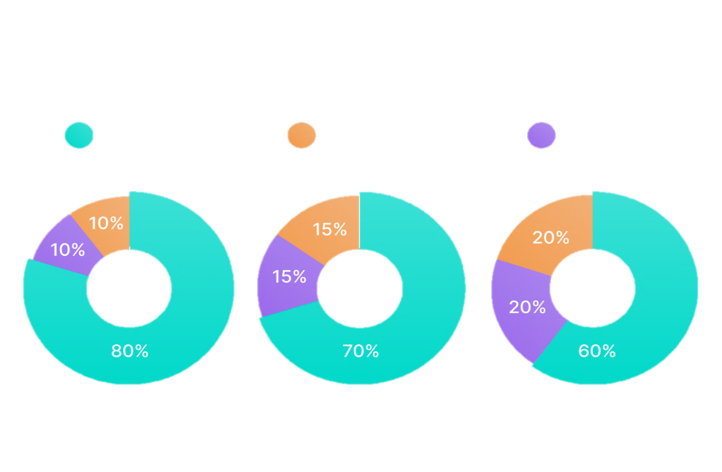
Training and Testing
For training and testing purposes the model, the data is to be broken down into three distinct dataset splits –
Training Data
Validation Data
Testing Data
Training Validation Testing

Slide 10
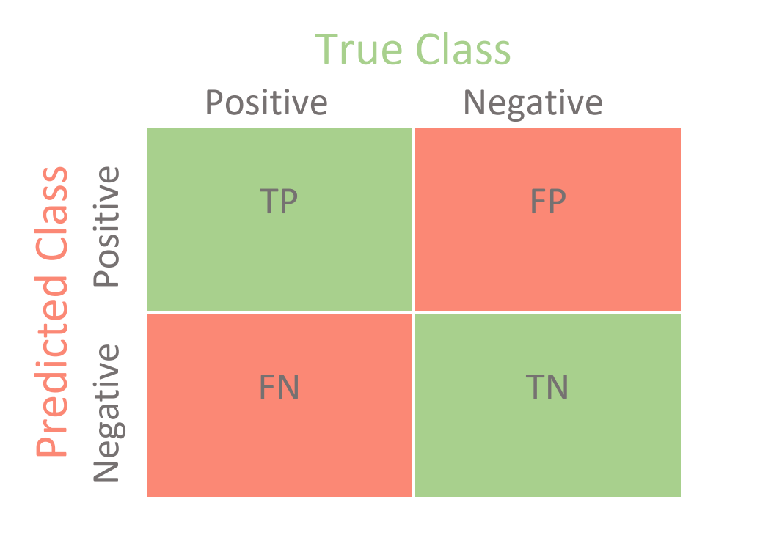
Performance Criteria:
Accuracy is ratio of correctly predicted observation to the total observations
Precision is the ratio of correctly predicted positive observations
to the total predicted positive observations.
Precision = TP/TP+FP
Recall is the ratio of correctly predicted positive observations
to the all observations in actual class
Recall = TP/TP+FN
Accuracy = (TP + TN)/(TP + TN + FP + FN)

Slide 11
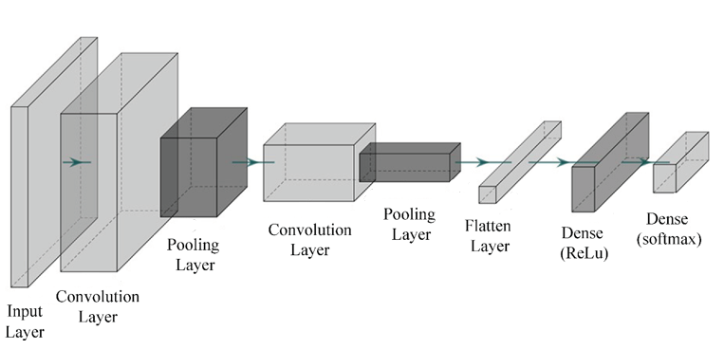
LeNet - 5
Lenet-5 is one of the earliest pre-trained models proposed by Yann LeCun and others in the year 1998.
The main reason behind the popularity of this model is its simple and straightforward architecture. It is a multi-layer convolution neural network for image classification.

Slide 12
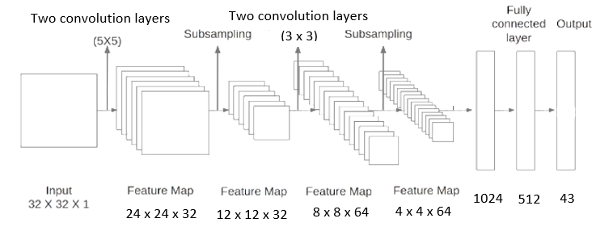
It has four sets of convolution layers with a combination of max pooling and dropout layers.
After the convolution and max pooling layers, we have flatten layer and two fully connected layers.
At last, a SoftMax classifier which classifies the images into respective class.

Slide 13
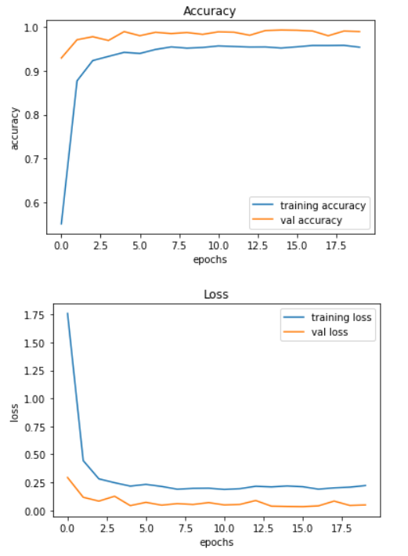
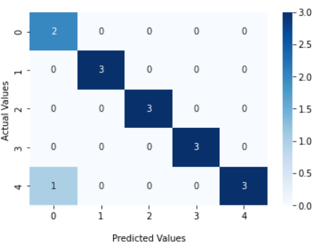
RESULTS
Training and Testing
Confusion Matrix
Training Accuracy and Loss

Slide 14
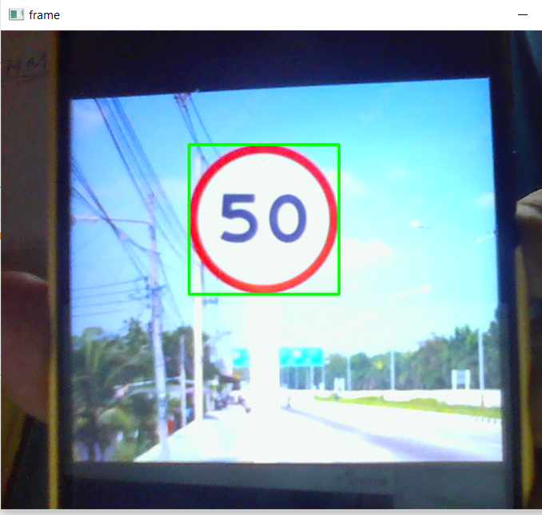
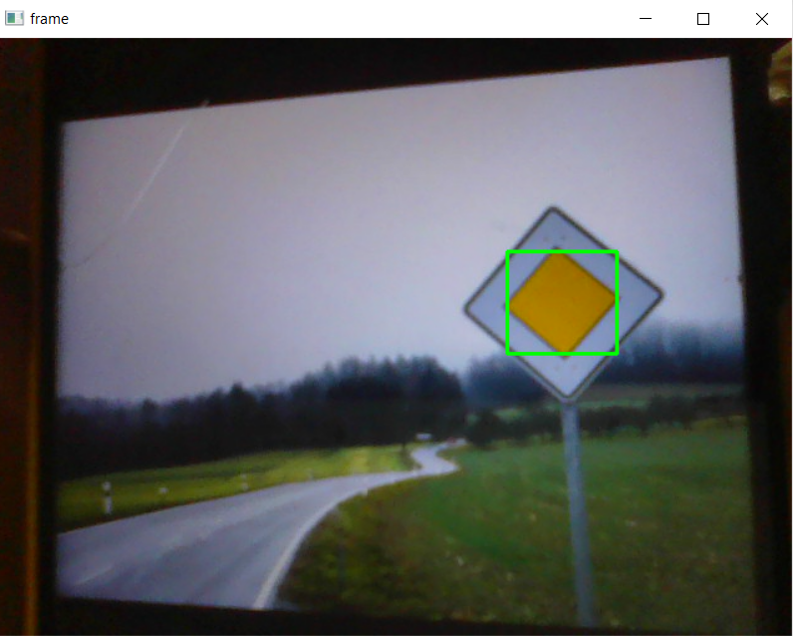
Sign Board
Detection

Slide 15
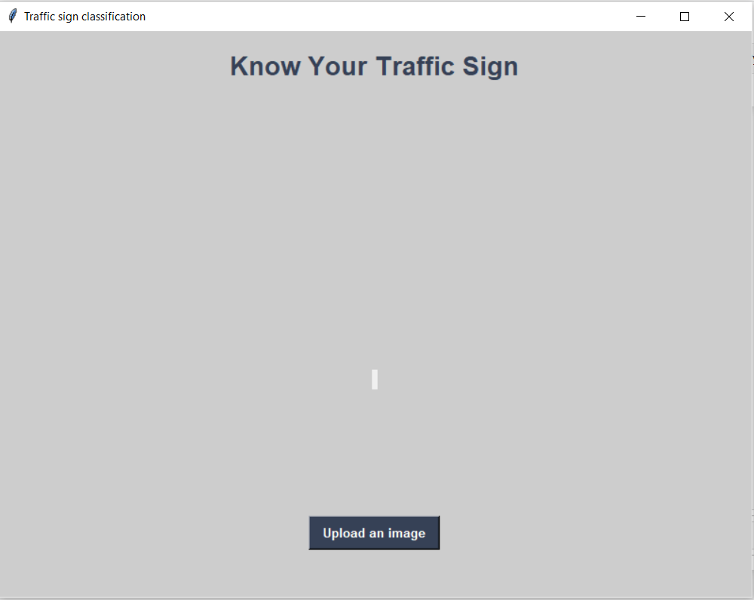
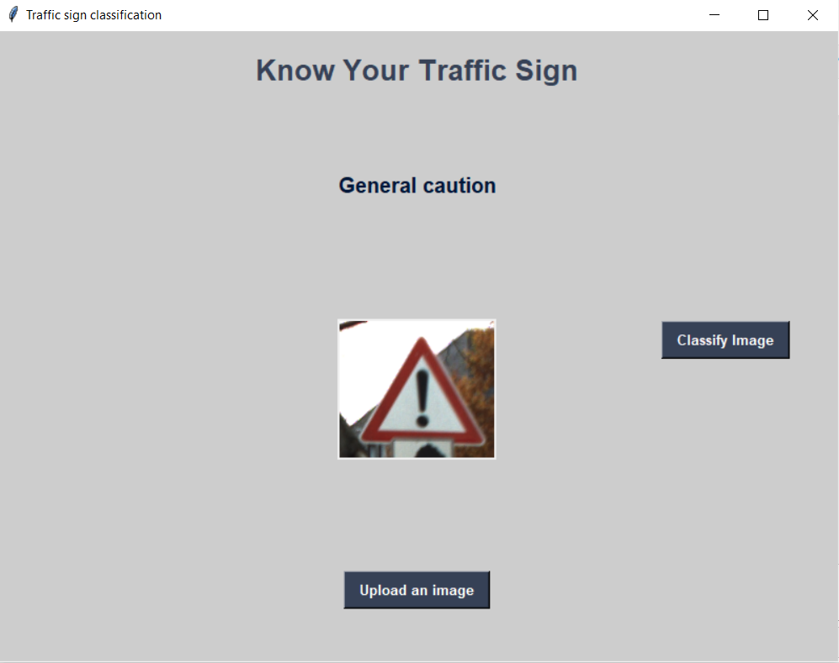

GUI Output
Initial GUI Display
Classification by GUI
After Uploading Image

Slide 16
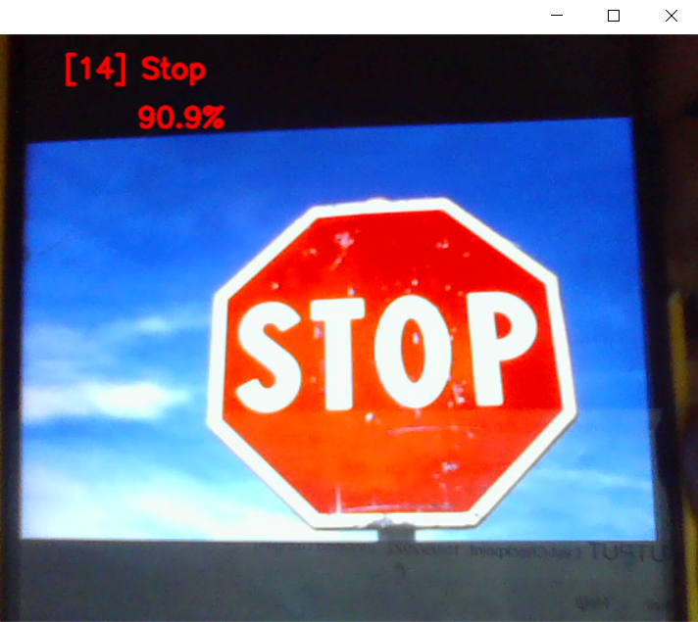
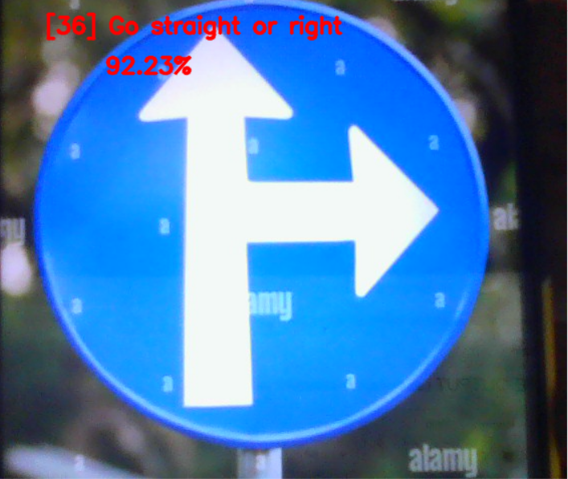
Live Capture

Slide 17
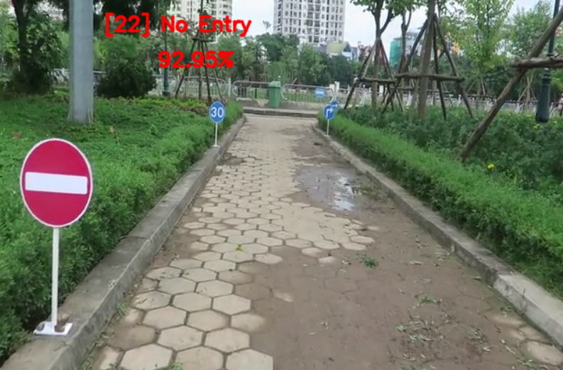
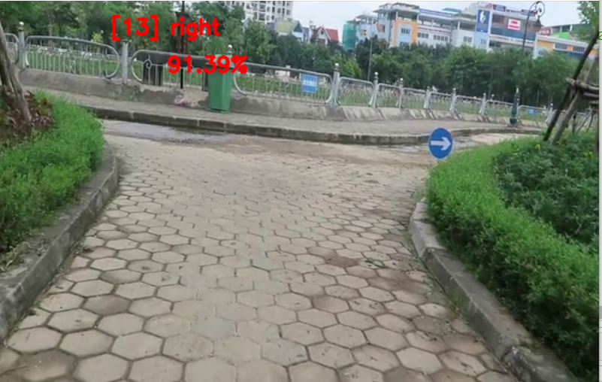
Video Capture

Slide 18
ADVANTAGES
Reduction in number of accidents
Automated Driving
Driver Safety
Advanced Driver Assistance Systems (ADAS)
Low budget auto pilot vehicles

Slide 19
DISADVANTAGES
The existence of a number of similar objects in the scene.
The presence of obstacles in the scene which can partially or totally occlude the sign.
The amount of information in the scene is vast and time is needed to analyse the scene and extract the desired information.
Difficult conditions of image acquisition

Slide 20
FUTURE SCOPE
Traffic sign detection and recognition plays an important role in expert systems, such as traffic assistance driving systems and automatic driving systems.
It instantly assists drivers or automatic driving systems in detecting and recognizing traffic signs effectively.
In near future this system can be deployed into ‘Low Budget Auto Pilot Vehicles’.
This system can be used in ADAS to only assist the driver about the traffic signs ahead or can be used directly to take appropriate action automatically

Slide 21
CONCLUSION
As a conclusion, this proposal successfully uses various pre-processing techniques to process the input and recognise the traffic sign appropriately and then send a voice alert through speaker.
It uses both standard GTSRB Dataset and a developed Dataset for the training of LENET 5
The Results of the last layer of cnn is used to classify the input into one of the traffic sign classes.

Slide 22
THANK YOU

